Slide 1
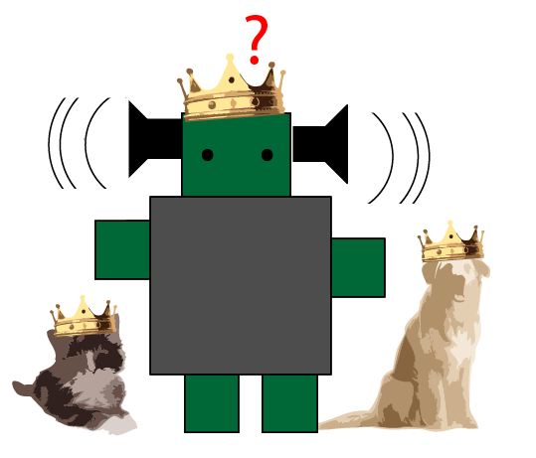


HCIM Capstone Project Pano Papadatos Mona Leigh Guha Tamara Clegg
Clinky the Robot: Preliminary Programming for Preschoolers

Slide 2
Clinky the Robot
Problem
Young Children lack exposure to Programming

Slide 3
Clinky the Robot
Why is that a problem? (Motivation)
Harnessing the full potential of Computers^{[1]}
Debugging skills are beneficial to everyone^{[2, 3, 4]}
Computer Science: Not the most diverse field^{[5, 6]}

Slide 4
Clinky the Robot
Can they do it?
Comfortable with computers^{[1]}
Independent in their exploration processes^{[2]}
Developmentally Appropriate^{[3]}
Children want to program^{[4]}

Slide 5
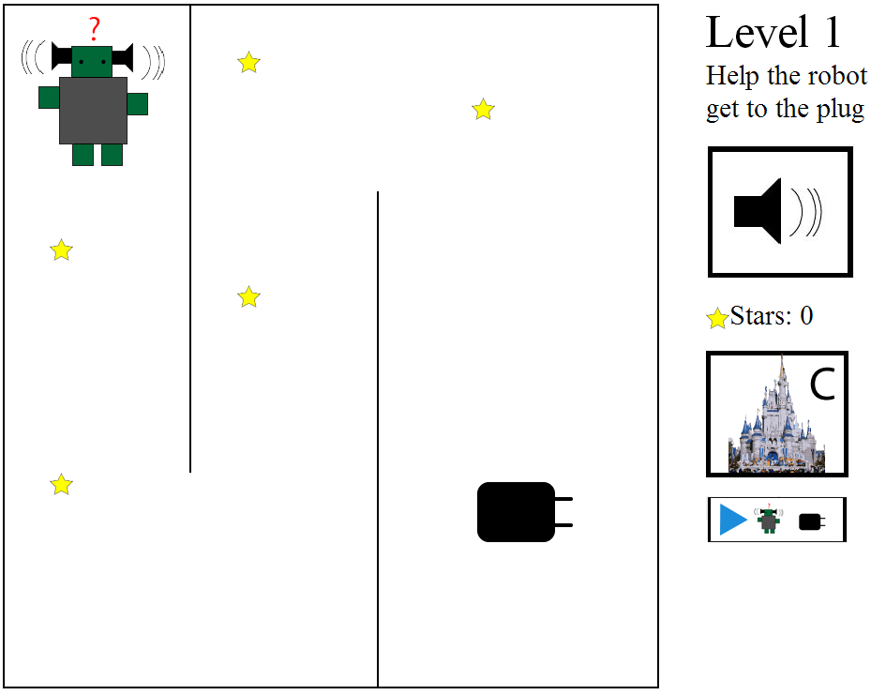
Clinky the Robot
Solution (Product)
iPad application to help young children (3-5) develop programming skills
Touch screens
Easy to use – Soon in Classrooms – Easily available

Slide 6
Clinky the Robot
Related Work
Product-focused (>5 years old) Logo & sons, Scratch, Toontalk, Alice, Move the Turtle
Research-focused Kahn & Morgado (Cookbook: 3-5)
McKnight & Fitton (Touch Screens)
Lin & Liu (Child-adult Collaboration)
Limitation of the field The bulk of the research is for older children and not on touch screens

Slide 7
Clinky the Robot
Related Concepts
Initial Taxonomy by Morgado and Cruz Syntax and Semantics, Compound Procedures, Parameter Passing, Parallel Execution
Wyeth:
Syntax and functionality
Achieving specific outcomes through programming
Reusing parts
Debugging
Planning
Building and comparing alternative solutions
Barr and Stephenson: Computational Thinking skills

Slide 8
Clinky the Robot
Design Approach
Cooperative Inquiry Techniques
Nothing Tangible
Literature Guidelines & Concepts
Implementation
Participatory Design
Formative Evaluation
Wireframing
Experts
Children

Slide 9
Clinky the Robot
Kidsteam
Children-Adult Design Partnership 8 Children, ages 7-11
Session 1: Robot activity and drawing (1h)
Goal: Initial Wireframe, Lots of ideas
Analysis: Big ideas, Debriefing, Observing themes
Results: GAME
Separate levels
Customizability & Upgrades
Collecting Items
Robots & Castles

Slide 10
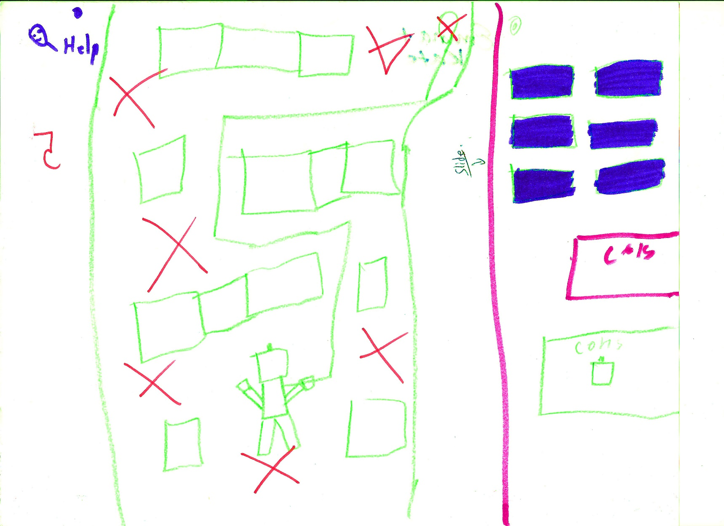
Drawing of the Application (Session 1)

Slide 11
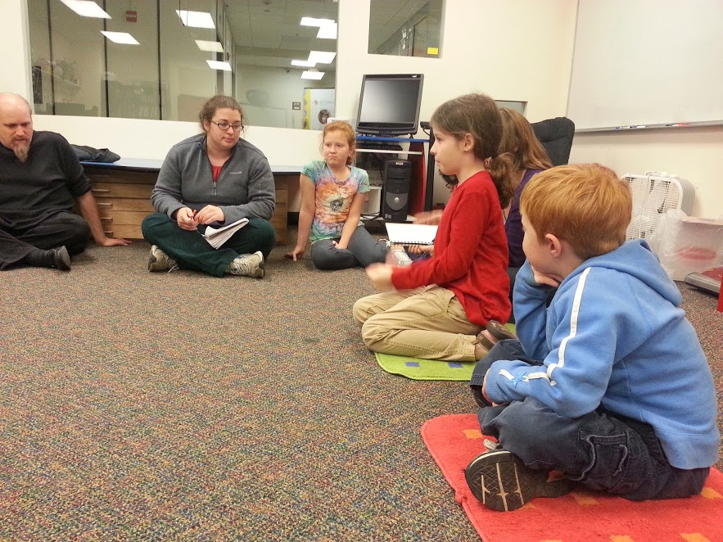
Circle Time!

Slide 12

Clinky the Robot
Kidsteam – Layered Elaboration
Session 2: Rapid Iterations & Rotations (1h)
Goal: Brainstorm and build on the wireframe
Analysis: Themes – Notes & Designs
Results: Animals
Personal Experience
Positive Feedback
Currency
Surprises

Slide 13
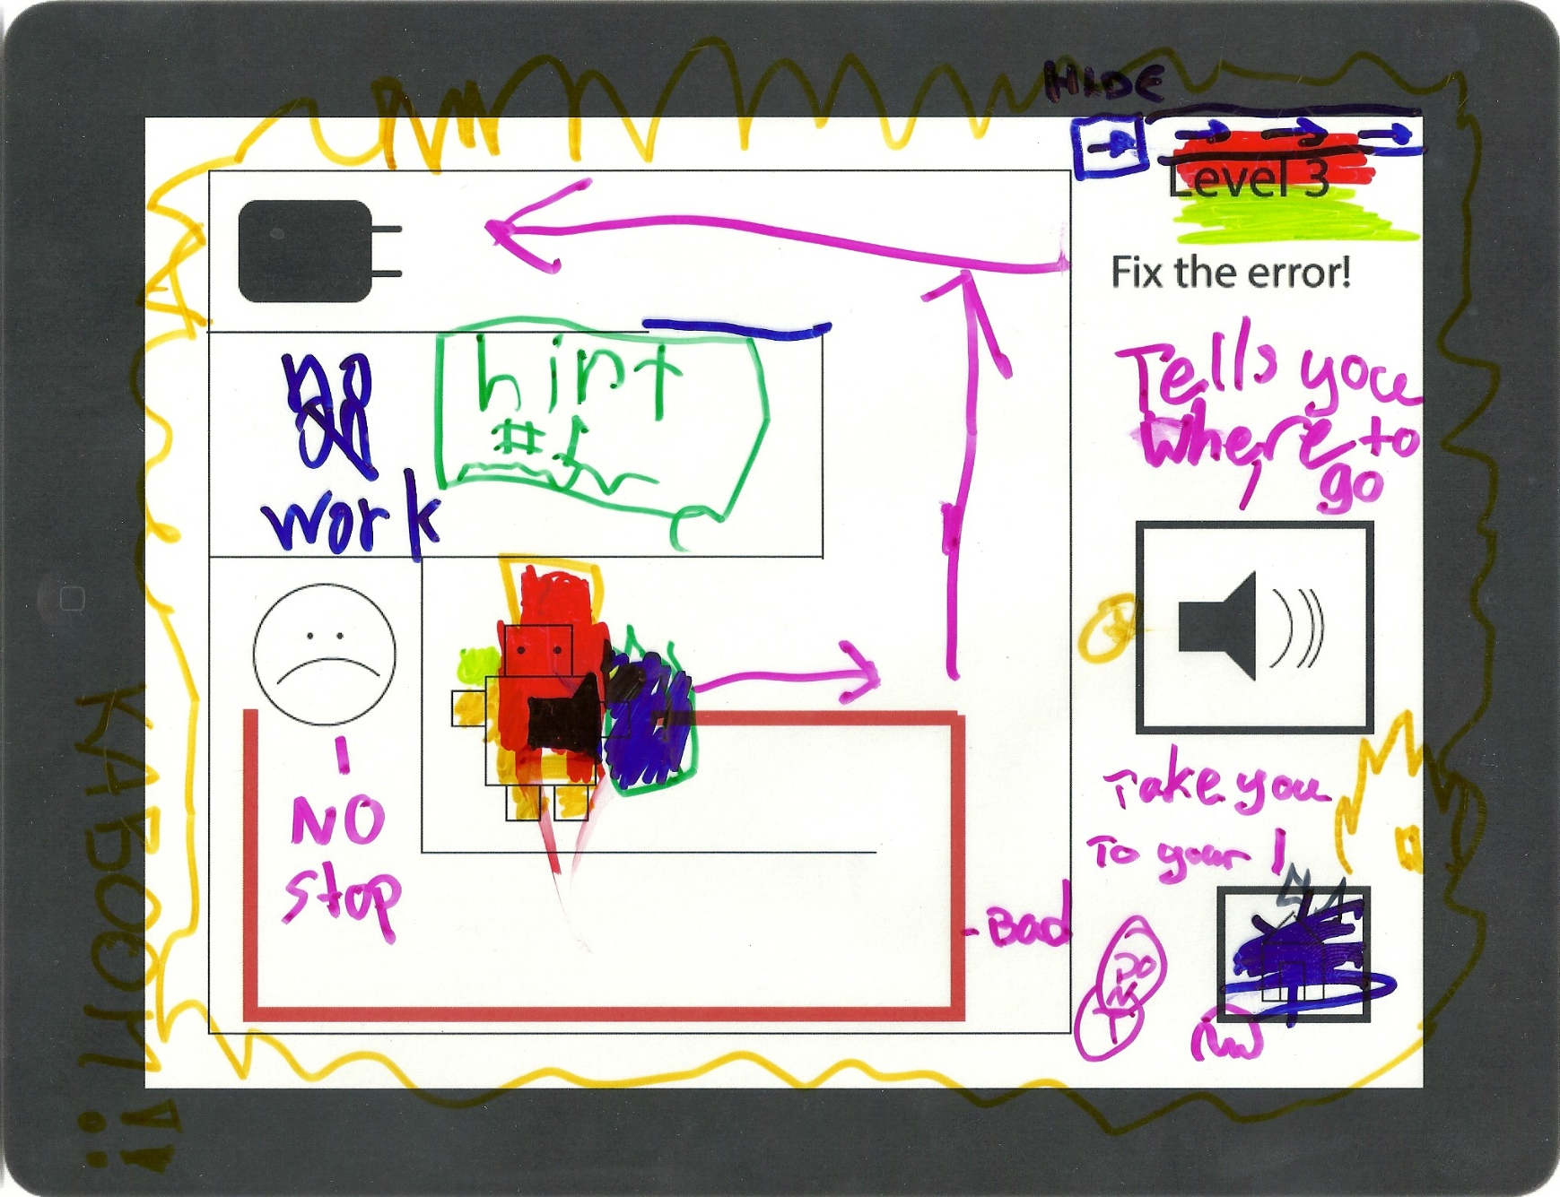
Layered Elaboration design

Slide 14
Clinky the Robot
Prototype (Demo)
5 levels
Robot & Castle
Stars as Currency
Upgrades

Slide 15
Clinky the Robot
Formative Evaluation - Experts
Sessions 3 & 4: Interviews - Teachers of 3 & 4, 5 (20m)
Goal: Quality of interactions & learning
Analysis: Commonalities and Disparities
Results: Age Appropriate (almost)
Repeating
Practical Guidelines
>Touch interactions, Instructions
Guided VS Independent

Slide 16
Clinky the Robot
Formative Evaluation - Children
Sessions 5, 6 & 8: (20m) 6 Children in pairs of two (3 & 5, 4 & 4, 4 & 4)
Goal: Formative evaluation (Usability & Challenges)
Results: What the teachers said
5/5 Ranking! ☺
Level 4 is too hard
Drawing could be hard
Declaring expectations
Castle and stars are motivating
Replaying

Slide 17
Clinky the Robot
Limitations
Not final
Evaluating learning outcomes
Not enough levels
Structuring the learning

Slide 18
Clinky the Robot
Future Work
Designing for 3, 4, 5 and 5+
Implementing Repetition
How do concepts evolve over time
Designing for independent VS guided
Improving Usability (instructions and interactions)

Slide 19
Clinky the Robot
Discussion
Children enjoy programming-like activities:
they can enrich the field of Computer Science
How do we integrate this in preschool education?
How do we scaffold the transition?
How do we design a guided activity?

Slide 20
Clinky the Robot
Conclusion
The children liked it!
They wanted to play it again
The process of helping them learn is complicated
Children change a lot between 3 and 5

Slide 21
Clinky the Robot
Acknowledgements
Special thanks to
Mona Leigh Guha and Tammy Clegg
Leah Findlater
Kidsteam
CYC Faculty, Staff & Children
My Classmates
HCIL

